Slide 1

Final Project DEPI
HSRP-OSPF Network Resilience Project
Supervised by : Engineer Khaled Abd rabu

Slide 2
Team members :
Menna Elgamel
Ahmed Abdslam
Fatma Elzhraa Adhem
Abanoub Mores
Hanaa Marzouk
Ahmed Emad

Slide 3
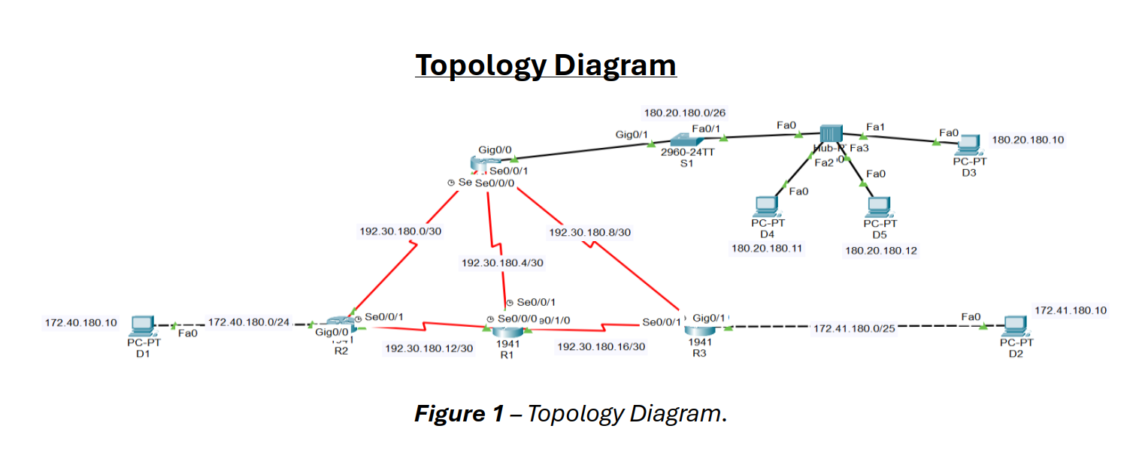
Topology Diagram :

Slide 4
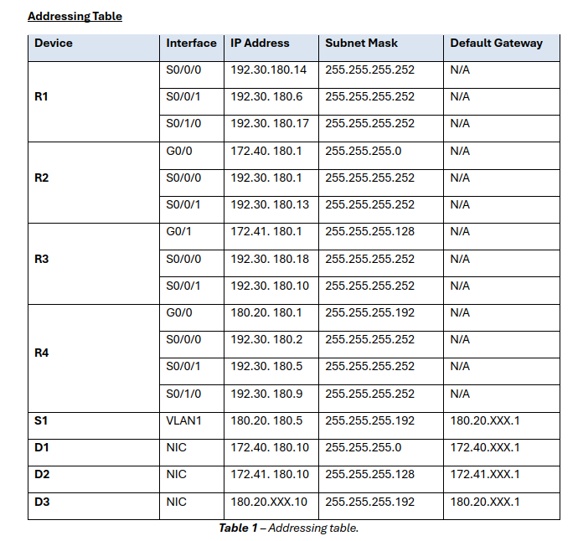
Addressing Table

Slide 5
Addressing Table
The lists interfaces, IP addresses, subnet masks, and gateways for:
Routers (R1 - R4)
Switch S1 (VLAN1 configuration)
Devices (D1, D2, D3)

Slide 6
Learning Objectives:
1
2
3
4
5
6
Configure Device Basic Settings
Switch Security Configuration
Configure OSPF Dynamic Routing Protocol
Standard ACL configuration
Verify Network Connectivity
Document the configuration

Slide 7

Scenario
01 02
configuring the routers to support IPv4 connectivity and LAN redundancy using HSRP.
configuring OSPF and verify connectivity. ​

Slide 8
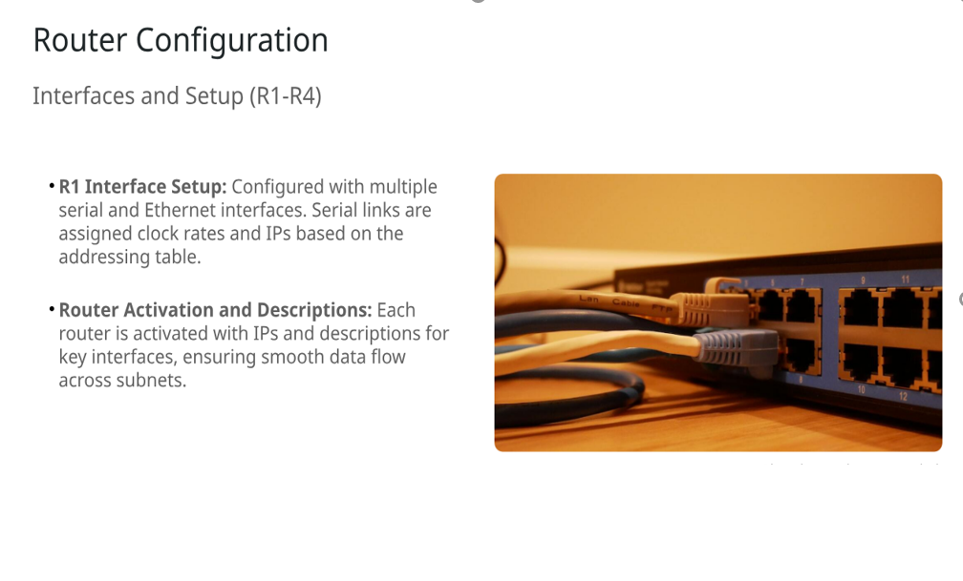
Router configuration
Setup
Interface

Slide 9
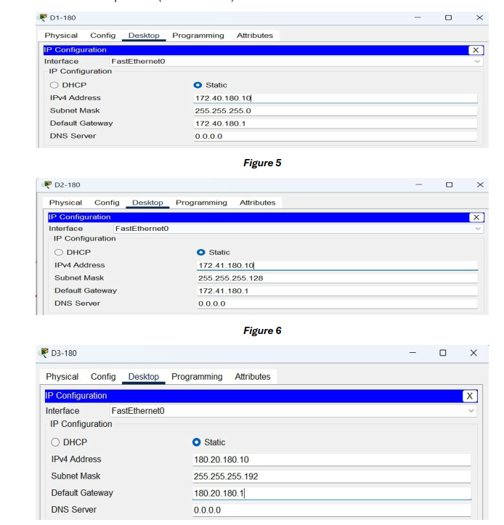
PC and switch configuration: Assign IPs to PCs via Desktop Tab
D1:
172.40.180.10
255.255.255.0
D2:
172.41.180.10
255.255.255.128
D3:
180.20.180.10
255.255.255.192

Slide 10
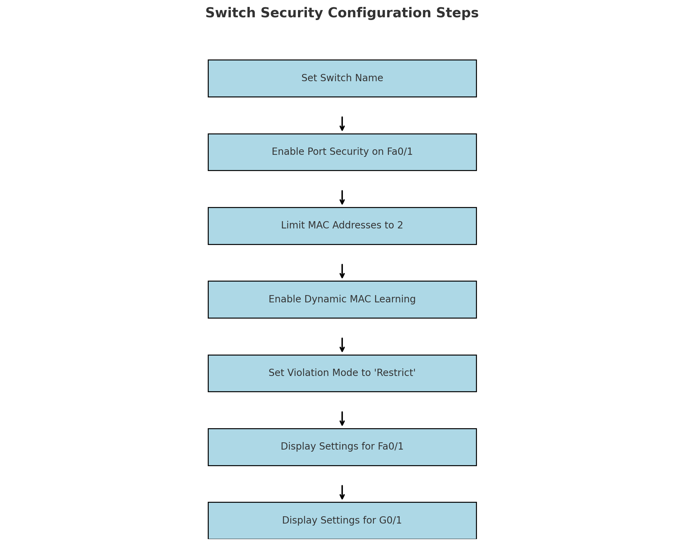
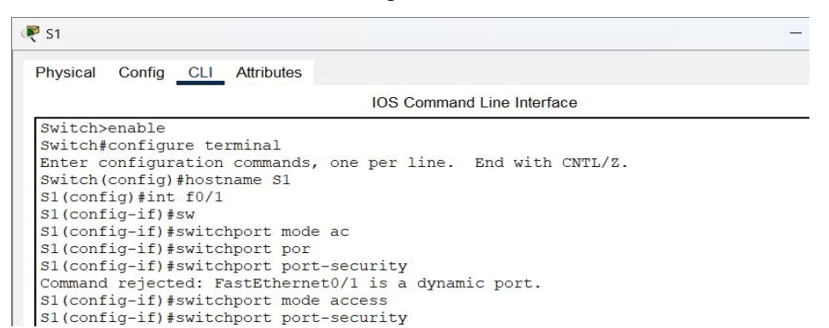
Switch Security Configuration:

Slide 11

Testing the Switch Security
Add PCs: Connect two additional PCs (D4 and D5) to the hub.
IP Addresses: Assign D4 with 180.20.180.11 and D5 with 180.20.180.12 from the 180.20.180.0/26 network.
Ping Test:
Ping the R4 interface G0/0 (180.20.180.1) from D3, D4, and D5.
Verify MAC Addresses:
Use the show run command to check that MAC addresses are "sticking."

Slide 12
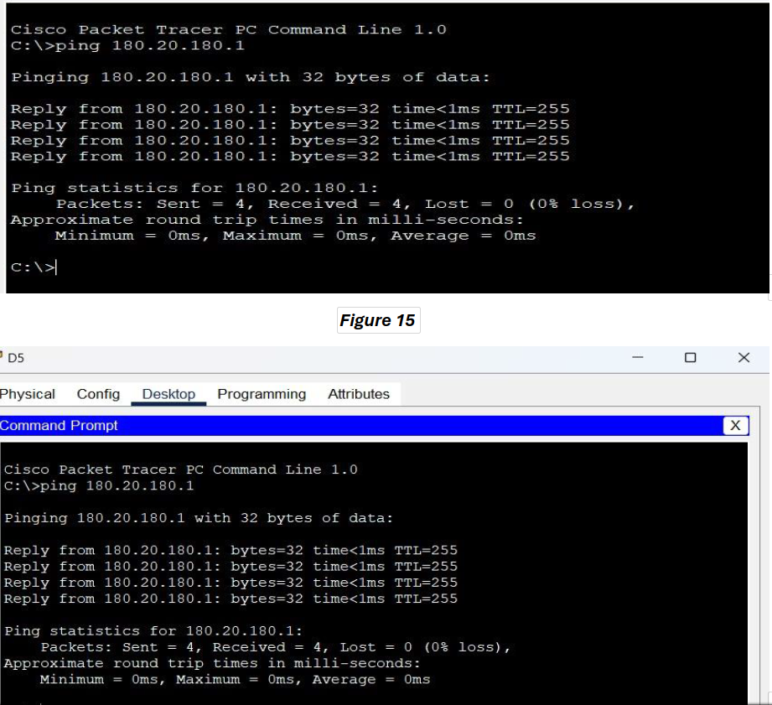
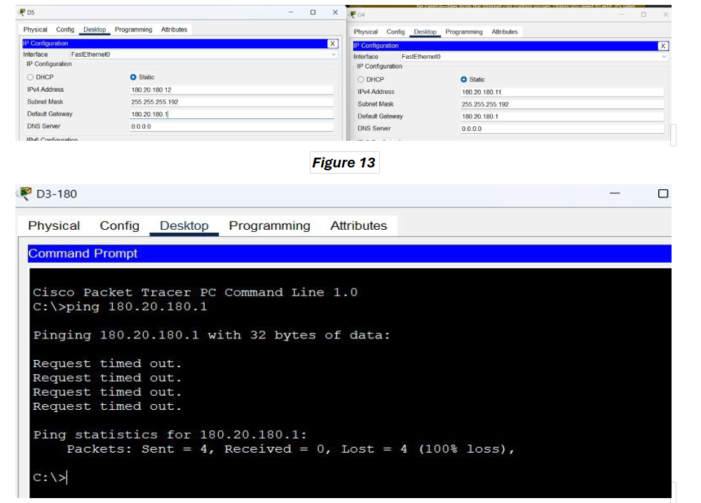

Slide 13

OSPF Dynamic Routing Protocol Configuration
Step 1: Configure OSPF on R1
Configure OSPF on R1.
Advertise all directly connected networks in area 0 using classless network addresses.
Step 2: Configure OSPF on R2
Configure OSPF on R2.
Advertise all directly connected networks in area 0 using classless network addresses.
Set interface G0/0 as passive.
Step 3: Configure OSPF on R3
Configure OSPF on R3.
Advertise all directly connected networks in area 0 using classless network addresses.
Set interface G0/1 as passive.
Step 4: Configure OSPF on R4
Configure OSPF on R4.
Advertise all directly connected networks in area 0 using classless network addresses.
Set interface G0/0 as passive.

Slide 14
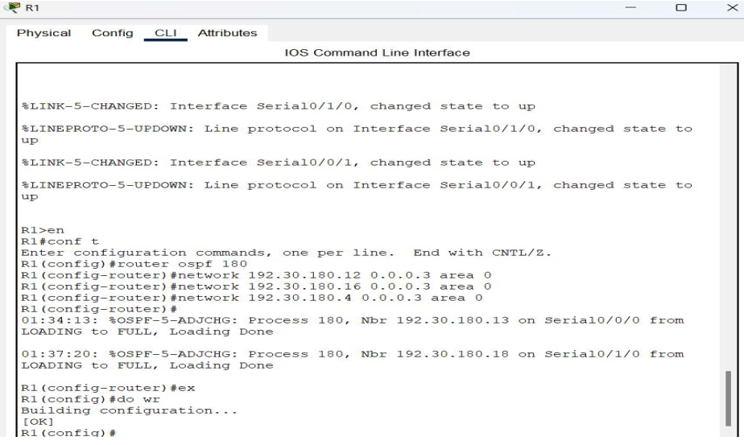
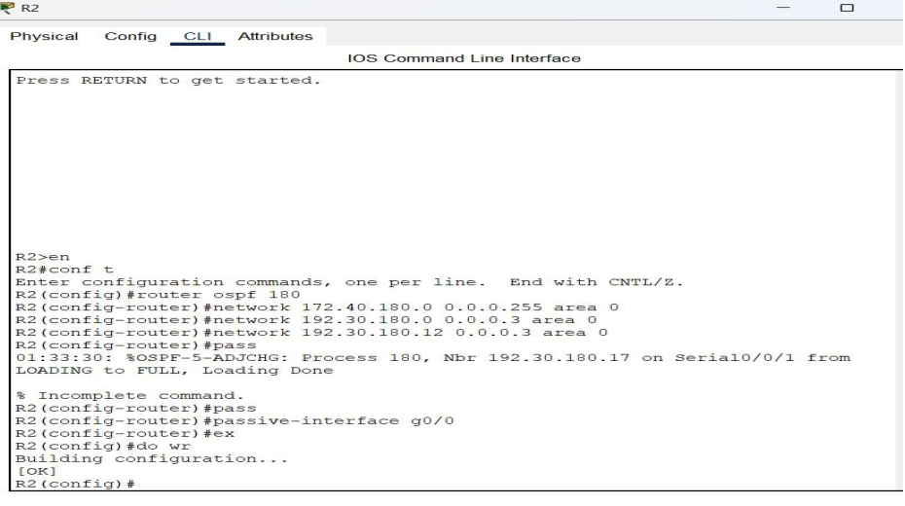
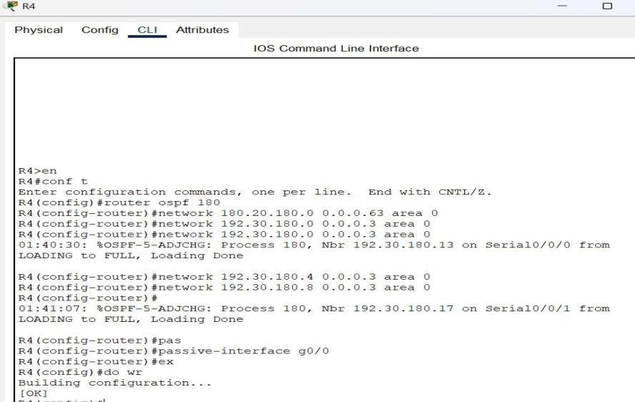

Slide 15
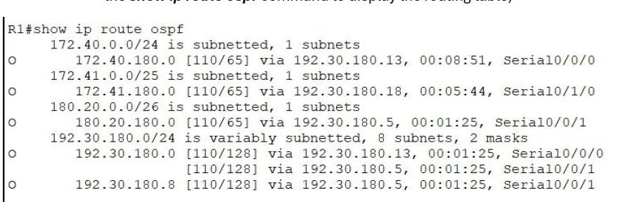
OSPF Verification and Ping Testing Verify OSPF Configuration
1
Display the routing table on router R1.
(use the show ip route ospf command to display the routing table).

Slide 16
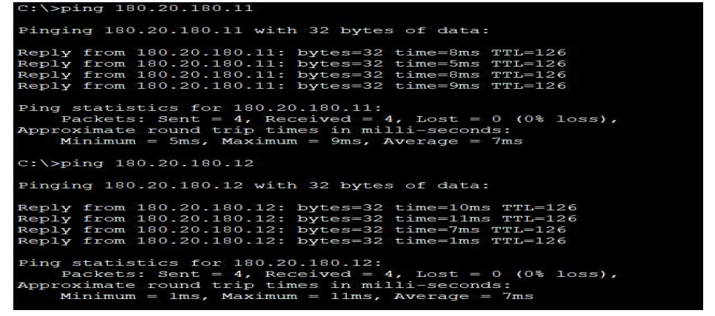
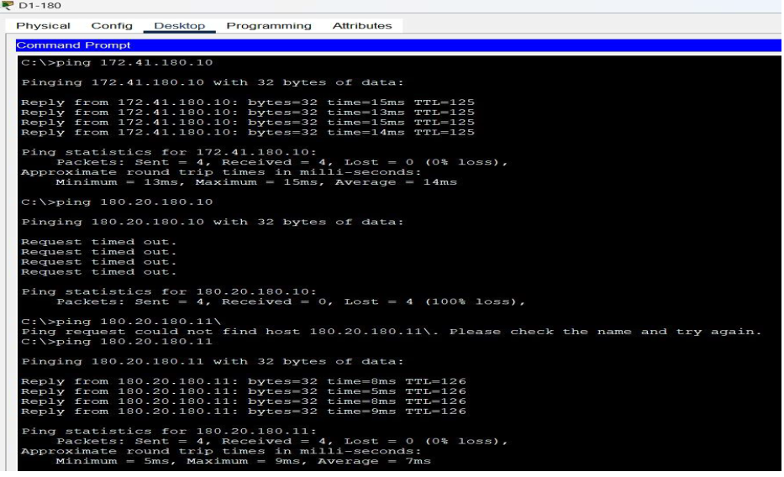
From D1 Ping:
D2 (172.41.180.10)
D3 (180.20.180.10)
D4 (180.20.180.11)
D5 (180.20.180.12)
2

Slide 17

Configure a Standard ACL on R4:
Step 1: Configure the Standard ACL
Allow devices on 172.40.180.0/24 to access 172.41.180.0/25 except D1 (172.40.180.10).
Allow 2 devices from 180.20.180.0/26 (pinged by D1) to access 172.41.180.0/25.
Permit other traffic on 172.41.180.0/25.
Use access list number 80.
Step 2: Apply the ACL
Apply to Router R3 interface G0/1 for exiting traffic.
Step 3: Test the ACL a) From D1 and two hosts on 180.20.180.0/26, ping D2 (should not succeed from D1). b) Change D1’s IP to 172.40.180.20, then ping D2 (should succeed only for D1).

Slide 18
Summary
project aims to Enhance our practical skills in
network configuration
security

Slide 19
Thank you
Do you have any questions ?

